Slide 1
Contrast Stretching , Intensity and bit plane slicing, histogram equalization
Md. Ferdous
Lecturer
Dept. of CSE
BSMRSTU

Slide 2
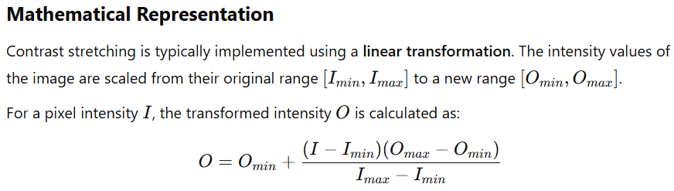
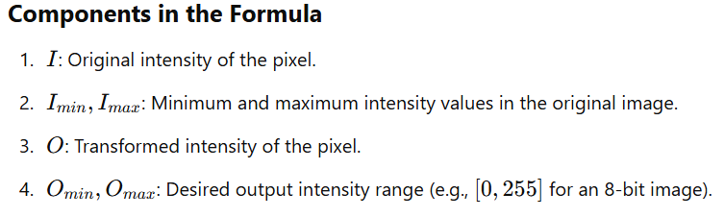
Contrast Stretching
Contrast stretching is a mathematical technique used in image processing to enhance the contrast of an image. It adjusts the range of intensity values in the image to occupy a broader spectrum, making features more distinguishable.

Slide 3
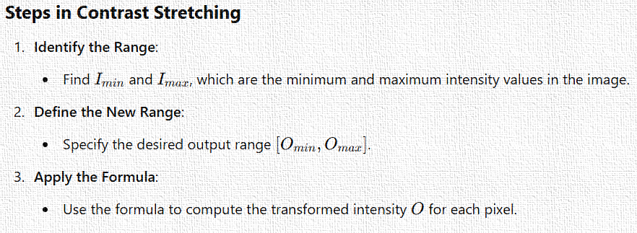
Contrast Stretching

Slide 4
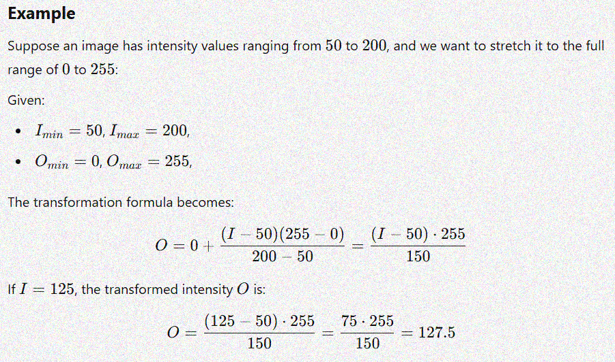
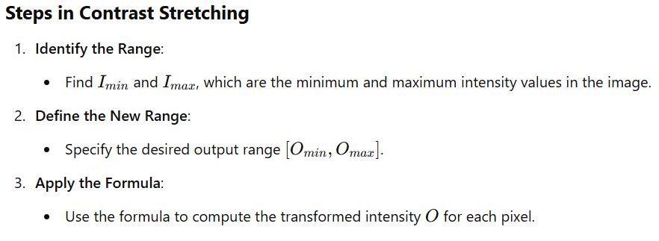
Contrast Stretching

Slide 5
Intensity-Level Slicing
Intensity-level slicing is an image enhancement technique used to highlight specific ranges of intensity levels in an image while suppressing others. It’s particularly useful in applications like medical imaging and satellite image analysis, where emphasizing certain features is important.
Types of Intensity-Level Slicing
Binary Slicing:
Specific intensity levels (or a range) are highlighted, while all other intensity levels are set to a background value.
Often used to extract specific regions of interest.
Gray Level Slicing with Background:
Specific intensity levels are highlighted, but the background remains unchanged.
Used to emphasize certain intensity ranges while preserving context.

Slide 6
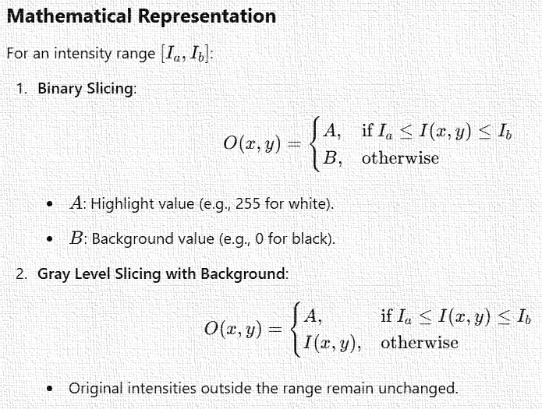
Intensity-Level Slicing

Slide 7
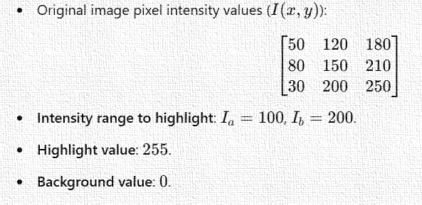
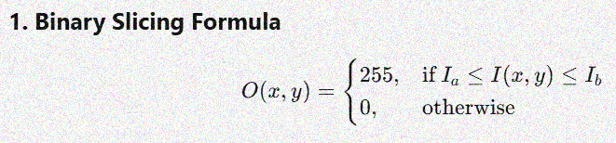
Intensity-Level Slicing

Slide 8
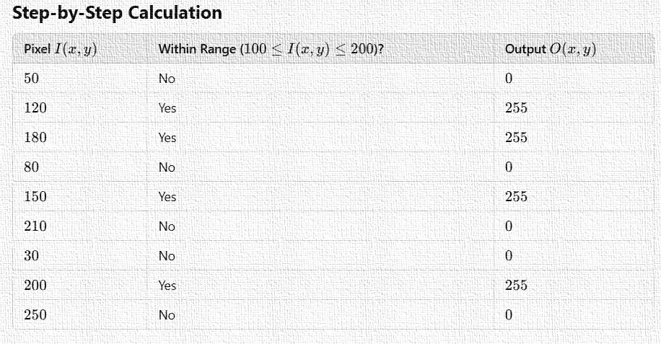

Intensity-Level Slicing

Slide 9
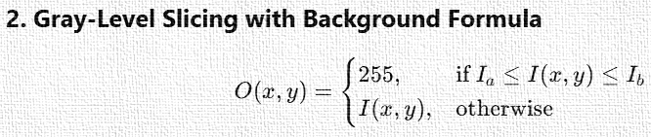

Intensity-Level Slicing

Slide 10
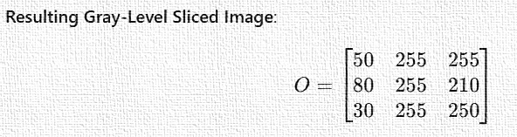
Intensity-Level Slicing

Slide 11
Bit plane slicing
Bit plane slicing is a technique used to visualize and analyze the contribution of each bit in the binary representation of pixel intensities in an image. Each pixel intensity is typically represented in an 8-bit format (ranging from 0 to 255), where each bit holds a specific weight.
In bit plane slicing, the image is decomposed into its individual bit planes. Each bit plane represents the contribution of a particular bit in the binary representation of the pixel values. This technique can be useful for understanding how different bits contribute to the overall appearance of an image.

Slide 12
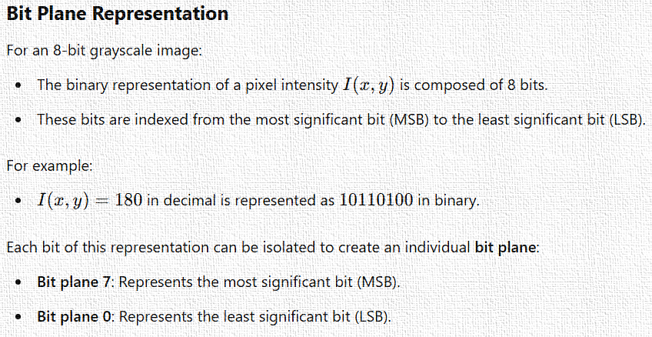
Bit plane slicing

Slide 13
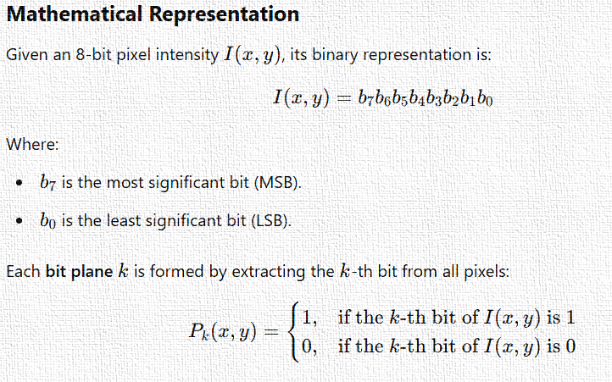
Bit plane slicing

Slide 14
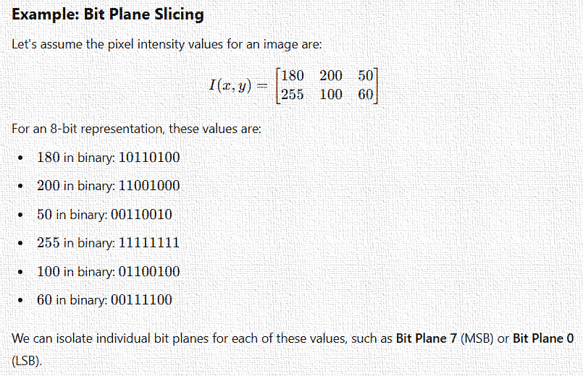
Bit plane slicing

Slide 15
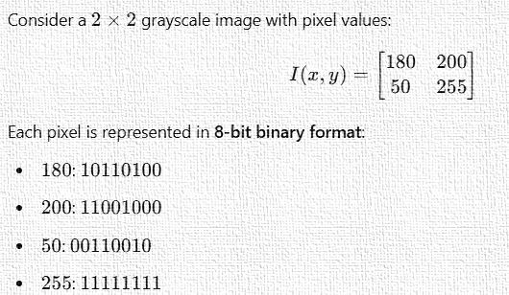
Bit plane slicing

Slide 16
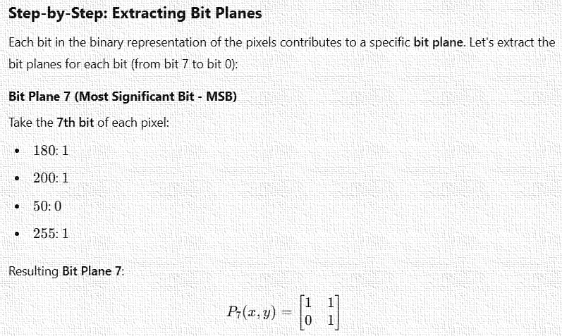
Bit plane slicing

Slide 17
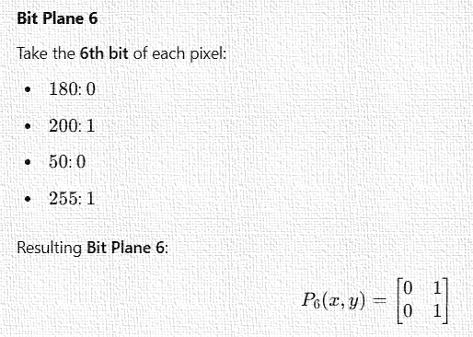
Bit plane slicing

Slide 18
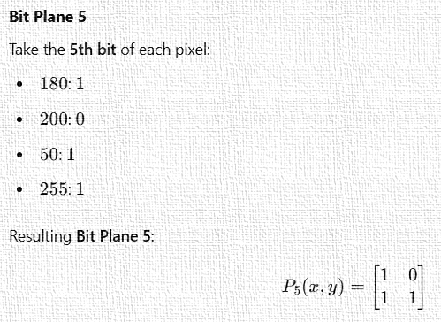
Bit plane slicing

Slide 19
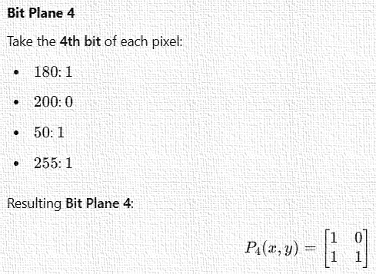
Bit plane slicing

Slide 20
Histogram Equalization
Histogram Equalization is a technique in image processing used to improve the contrast of an image. It redistributes the pixel intensity values so that the histogram of the resulting image is approximately uniform. This enhances image details, making the image appear clearer or more detailed.

Slide 21
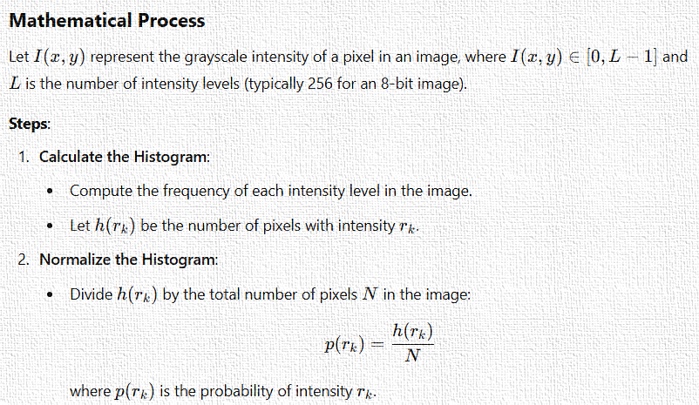
Histogram Equalization

Slide 22
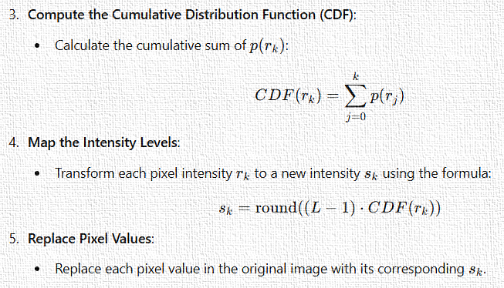
Histogram Equalization

Slide 23
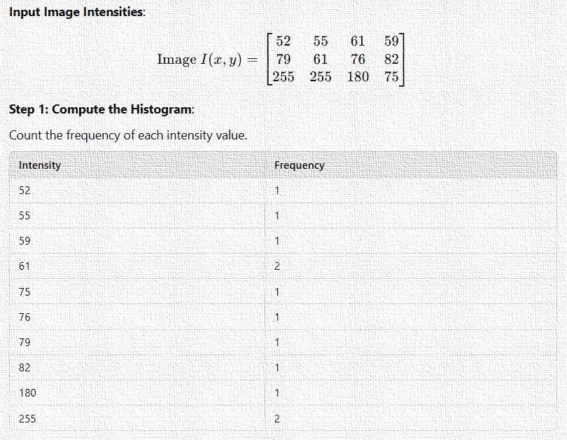
Histogram Equalization

Slide 24
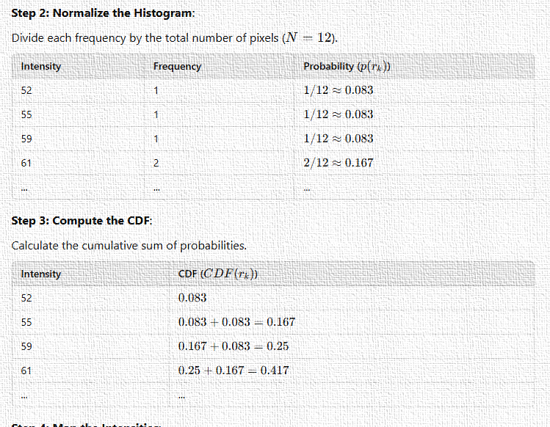
Histogram Equalization

Slide 25
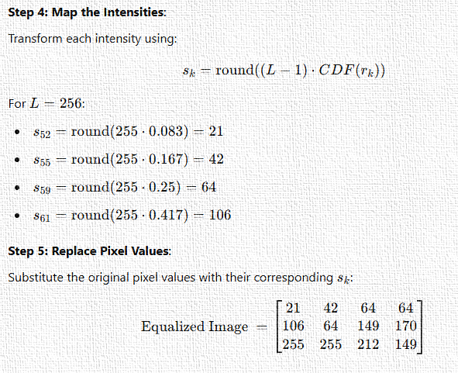
Histogram Equalization

